Slide 1



GROUP 2A
CAMPUS CONNECT: A WEB-BASED PLATFORM FOR MONITORING FACULTY-STUDENT ENGAGEMENT
BSIS BA 4A

Slide 2

KDF - Under objectives,
Instructor module - moderation of contents
RECOMMENDATIONS
CHAPTER 1

Slide 3

RECOMMENDATIONS
CHAPTER 1
XJPA - Specify what will be monitored
in the objectives

Slide 4
RECOMMENDATIONS
CHAPTER 1
XJPA - Specify minimum and maximum
slot and hours in the consultation.

Slide 5
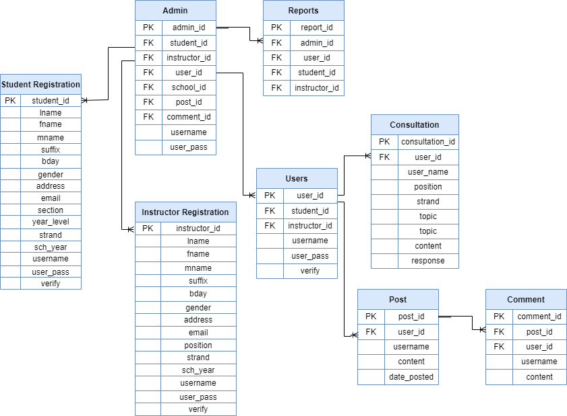
RECOMMENDATIONS
CHAPTER 4
XJPA - ERD: Include appointment subject
consultation
XJPA - ERD: Remove report, put consultation
schedule time, day and student subject for the
consultation.
XJPA - ERD: Re arranging diagrams

Slide 6




OBJECTIVES
To design and develop a Web-based Engagement Monitoring System for Faculty and Students incorporating the following features.
1.1Instructor Perspective
1.1.1Instructors’ Dashboard

Slide 7
OBJECTIVES
1.1.2Manage Students Consultation

Slide 8
OBJECTIVES
1.1.1.3 Set Appointment
1.1.3.1Virtual Chats or Meetings for Consultation

Slide 9
OBJECTIVES
1.1.1.4Set Availability Status

Slide 10
OBJECTIVES
1.1.5Interactions Through Chat Box or Discussion Boards

Slide 11
OBJECTIVES
1.1Students Perspective
1.1.1Students’ Dashboard

Slide 12
OBJECTIVES
1.1System Administrators’ (Principal) Perspective
1.1.1 Manage System

Slide 13
OBJECTIVES
1.1.1.1 Create Instructors’ Dashboard

Slide 14
OBJECTIVES
1.1.1.1Manage the performance of the platform

Slide 15
OBJECTIVES
1.1.1.1User Management
1.1.1.1.1Approval and Deletion of Account

Slide 16
OBJECTIVES
1.1 Guidance Councilor Perspective
1.1.1 Manage Students concern

Slide 17
OBJECTIVES
1.1.1 Review submitted concerns (from the students)

Slide 18
OBJECTIVES
1.1.1 Content Moderation ( accept or reject content)

Slide 19
OBJECTIVES
1.To evaluate the performance of Web-Based Engagement Monitoring System by Blackbox testing.
Specifically,
1.1Evaluation
1.1.1Functionality

Slide 20
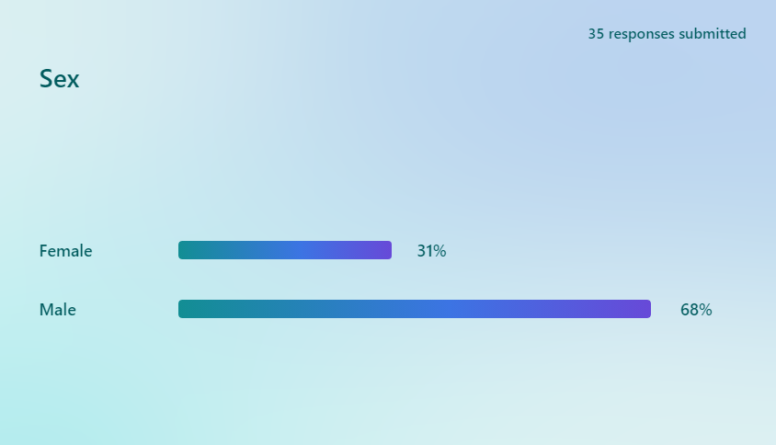
RESULT & DISCUSSIONS
Gender Distribution

Slide 21
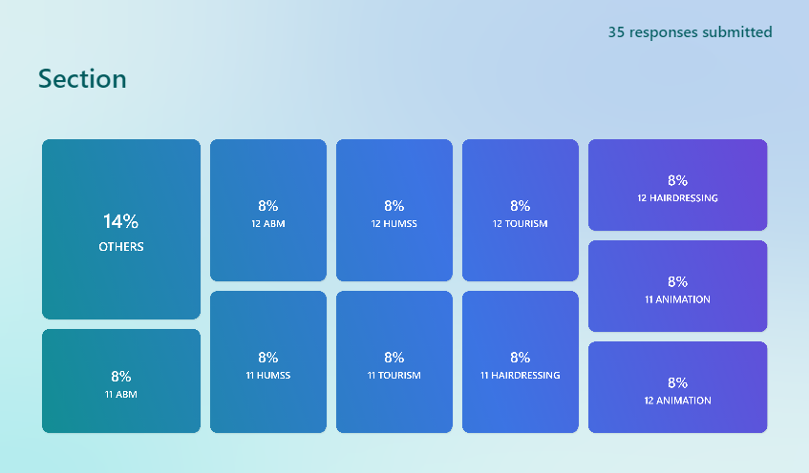
RESULT & DISCUSSIONS
Students Section
Others (Faculty, Principal, Guidance Counselor and IT Experts)
11 and 12 HUMSS: 6
11 and 12 ABM: 6
11 and 12 Animation: 6
11 and 12 Hairdressing: 6
11 and 12 Tourism: 6
others: 6

Slide 22
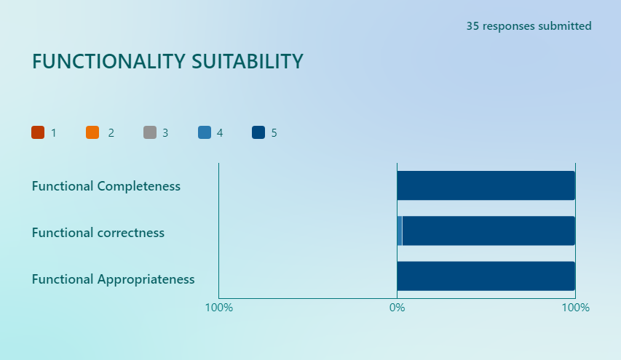
RESULT & DISCUSSIONS
Rating of the system’s functionality suitability by 35 users
Functional Completeness: 5 (PASSED)
Functional Correctness: 4.9 (PASSED)
Functional Appropriateness: 5 (PASSED)
Total: 4.9 (PASSED)

Slide 23
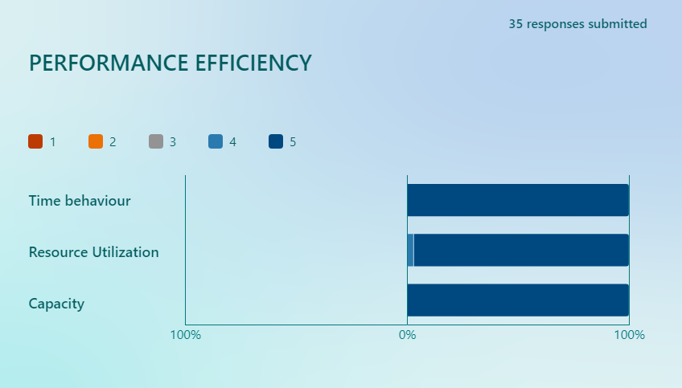
RESULT & DISCUSSIONS
Rating of the system’s performance efficiency by 35 users
Time behaviour: 5 (PASSED)
Resource Utilization: 4.9 (PASSED)
Capacity: 5 (PASSED)
Total: 4.9 (PASSED)

Slide 24
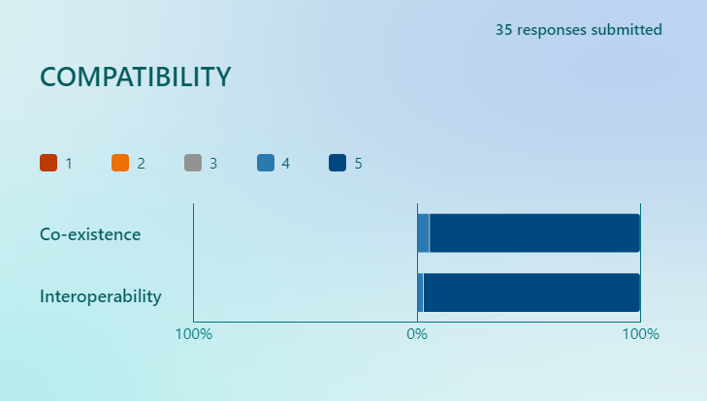
RESULT & DISCUSSIONS
Rating of the system’s compatibility by 35 users
Co-existence: 4.8 (PASSED)
Interoperability: 4.9 (PASSED)
Total: 4.8 (PASSED)

Slide 25
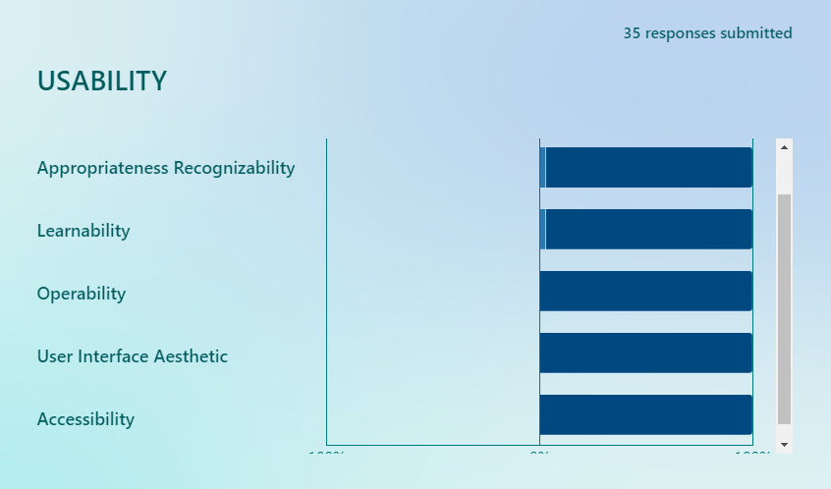
RESULT & DISCUSSIONS
Rating of the system’s functionality usability by 35 users
Appropriateness Recognizability: 4.9 (PASSED)
Learnability: 4.9 (PASSED)
Operability: 5 (PASSED)
User Interface Aesthetic: 5 (PASSED)
Accessibility: 5 (PASSED)
Total: 4.9 (PASSED)

Slide 26
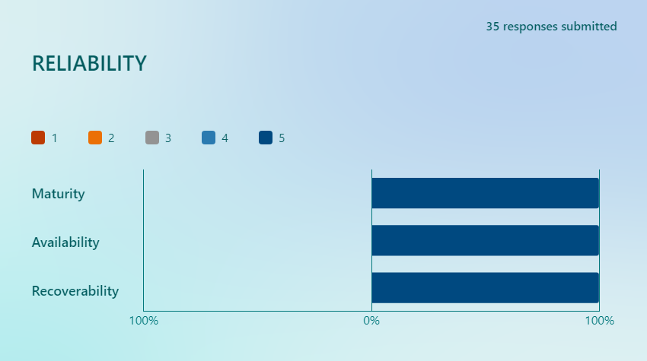
RESULT & DISCUSSIONS
Rating of the system’s reliability by 35 users
Maturity: 5 (PASSED)
Availability: 5 (PASSED)
Recoverability: 5 (PASSED)
Total: 5 (PASSED)

Slide 27
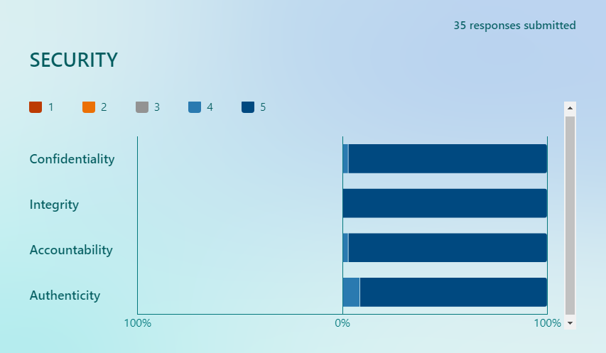
RESULT & DISCUSSIONS
Rating of the system’s security by 35 users
Confidentiality: 4.9 (PASSED)
Integrity: 5 (PASSED)
Accountability: 4.9 (PASSED)
Authenticity: 4.7 (PASSED)
Total: 4.8 (PASSED)

Slide 28
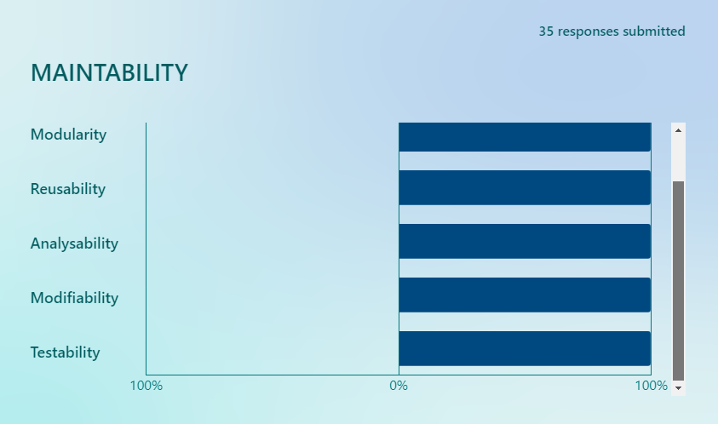
RESULT & DISCUSSIONS
Rating of the system’s maintability by 35 users
Modularity: 5 (PASSED)
Reusability: 5 (PASSED)
Analysability: 5 (PASSED)
Modifiability: 5 (PASSED)
Testability: 5 (PASSED)
Total: 5 (PASSED)

Slide 29
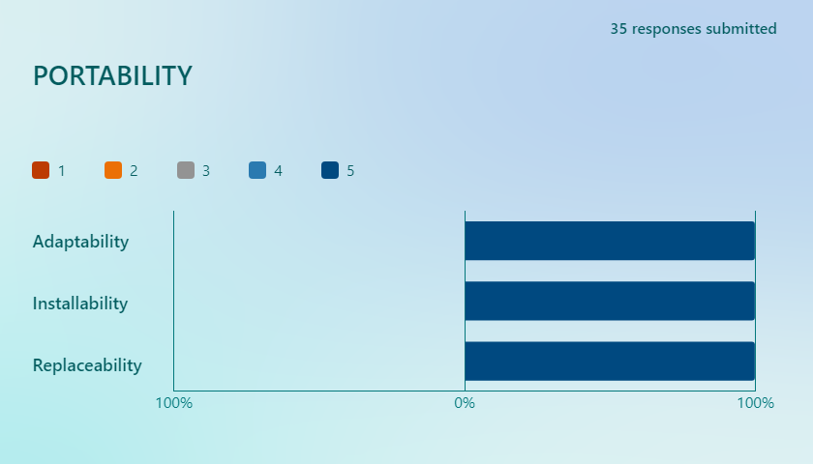
RESULT & DISCUSSIONS
Rating of the system’s potability by 35 users
Adaptability: 5 (PASSED)
Installability: 5 (PASSED)
Replaceability: 5 (PASSED)
Total: 5 (PASSED)

Slide 30
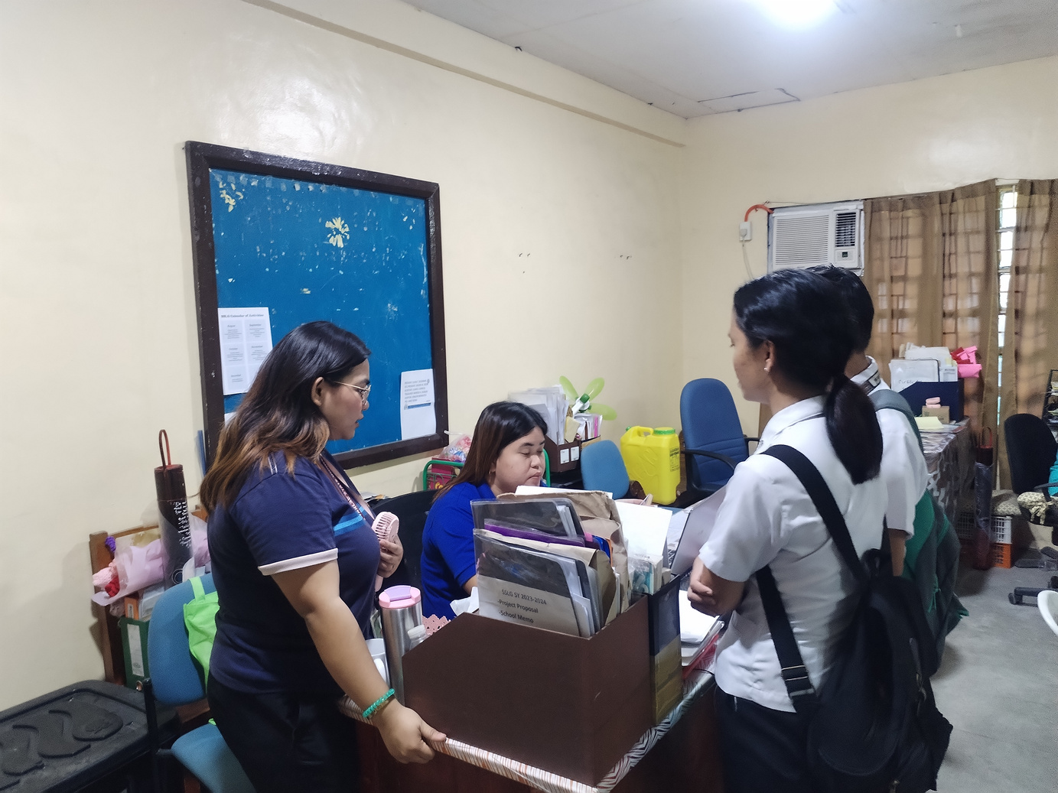
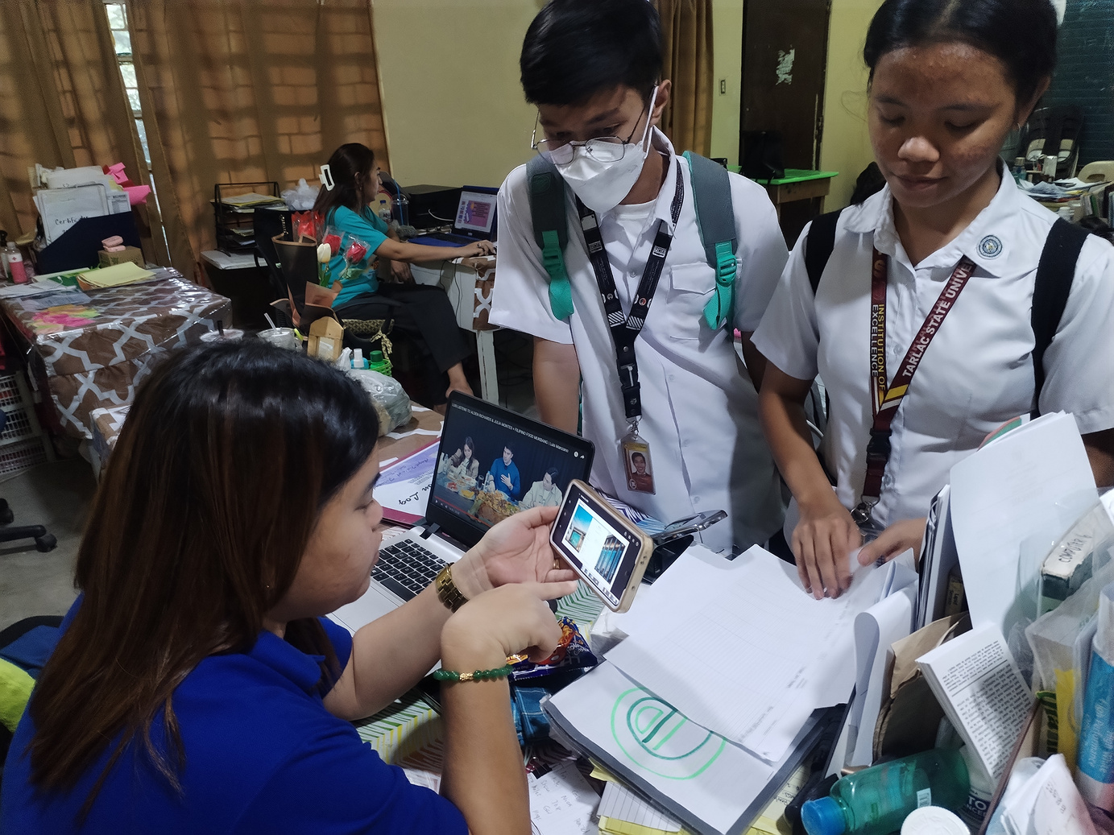
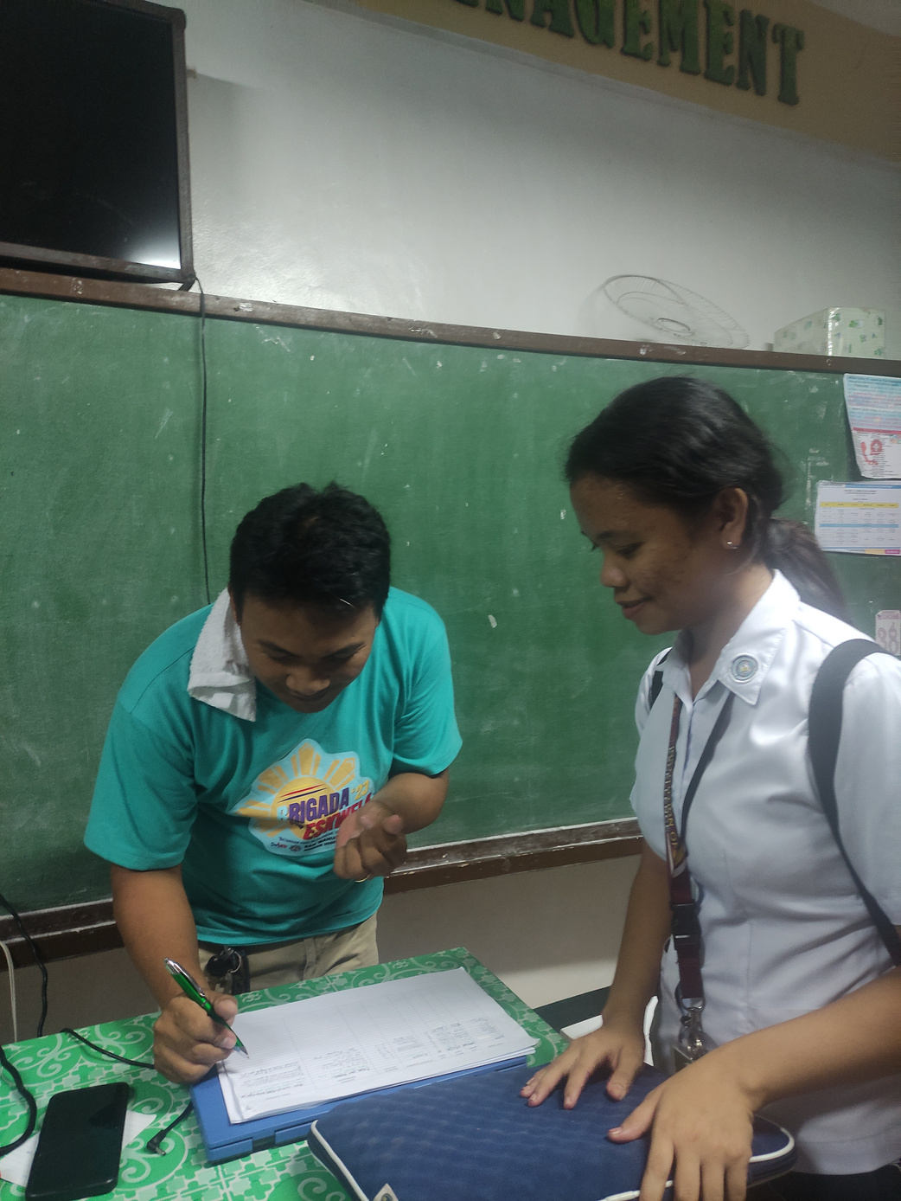
RESULT & DISCUSSIONS

Slide 31
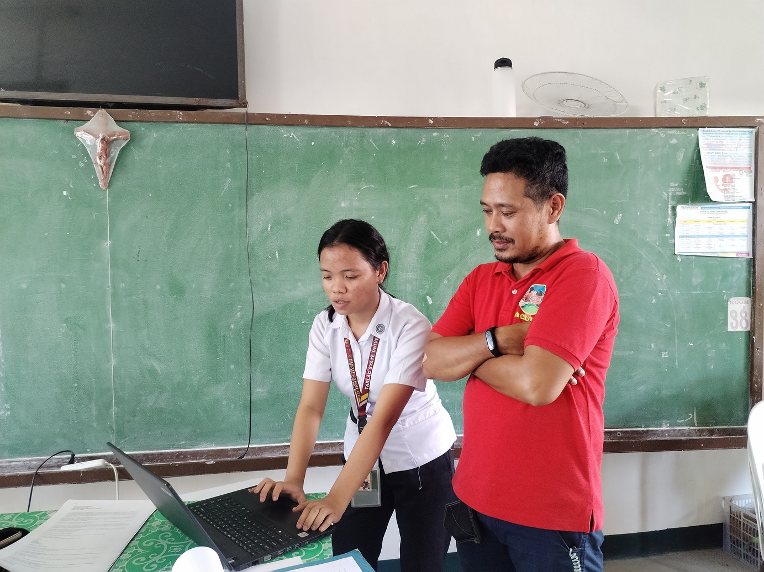
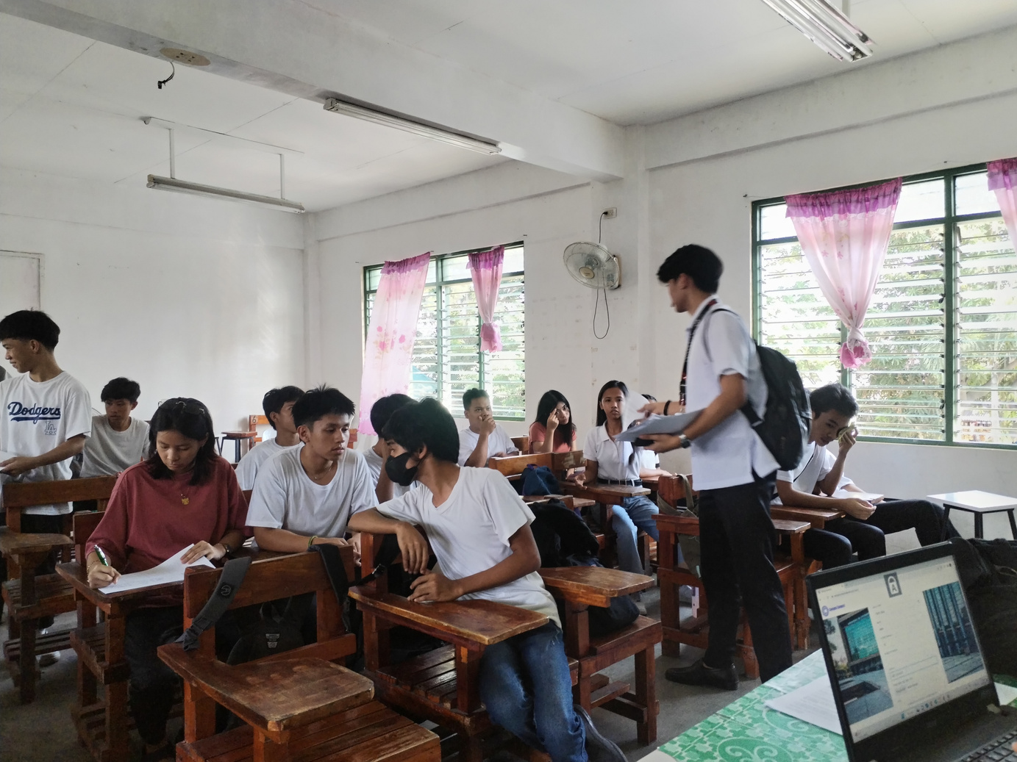
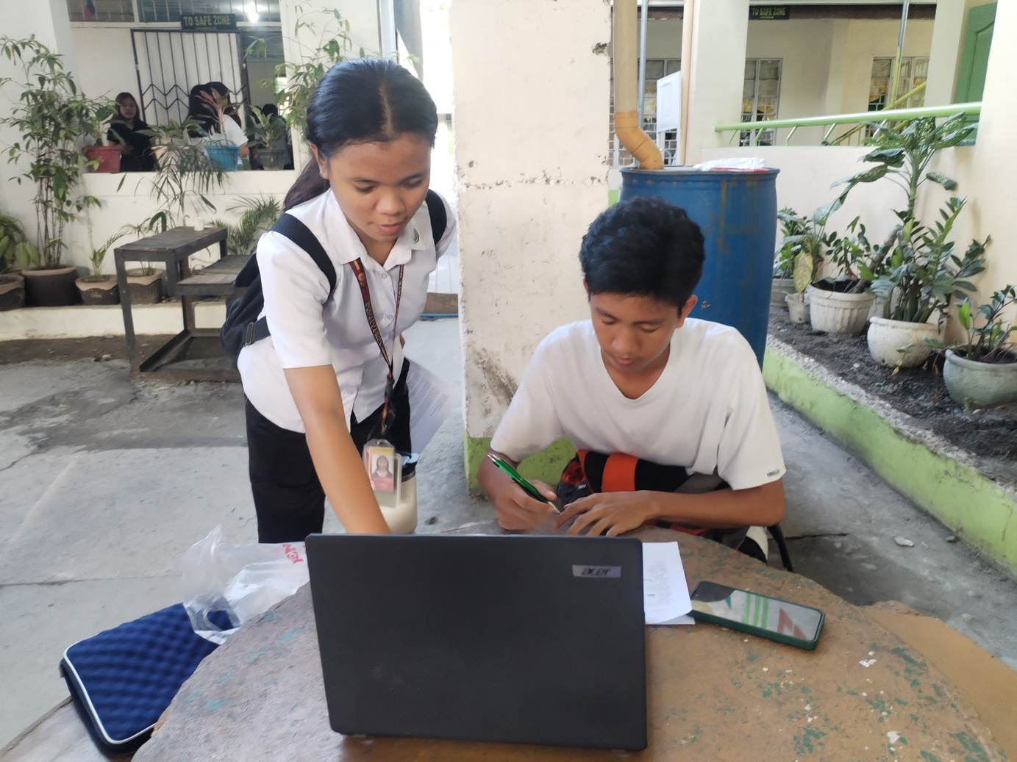
RESULT & DISCUSSIONS

Slide 32
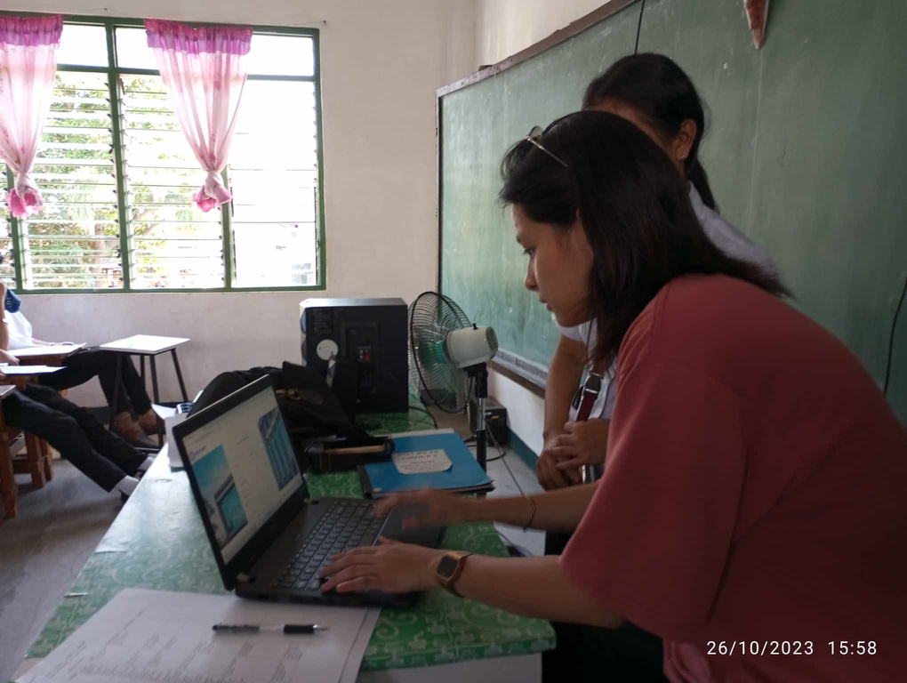
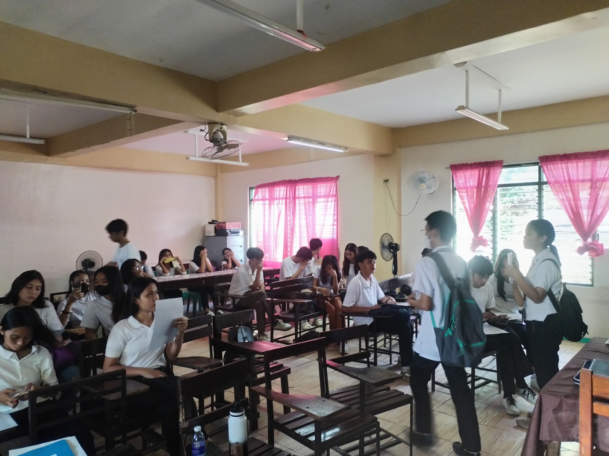
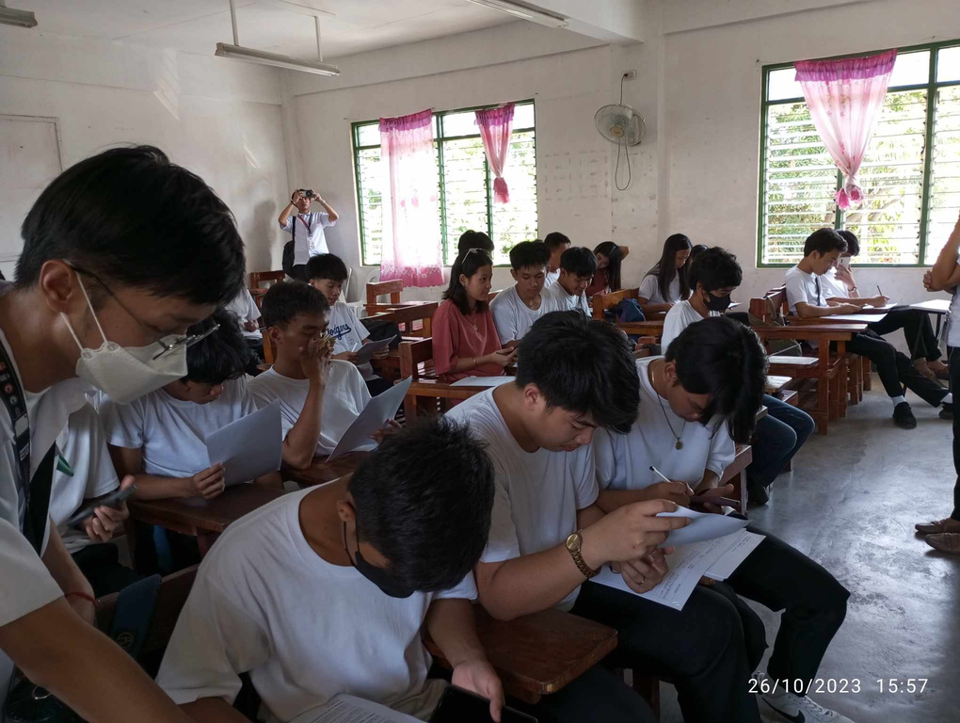
RESULT & DISCUSSIONS

Slide 33
CONCLUSION
The researcher were able to develop the following futures of “Campus Connect: A Web-based Platform for Monitoring Faculty-Student Engagement”
1.3 System Administrator Module
1.1 Instructor Module
1.1.1Instructors’ Dashboard
1.1.2Manage Students Consultation
1.1.3Set Appointment
1.1.3.1 Virtual Chats or Meetings for Consultation
1.1.4Set Availability Status
1.1.5Interactions Through Chat Box or Discussion Boards
1.3.1 Manage System
1.3.1.1 Create Instructors’ Dashboard
1.3.1.2 Manage the performance of the platform
1.3.1.3 Monitoring Student engagement and Analytics
1.3.1.4 User Management
1.3.1.4.1Approval and Deletion of Account
1.2 Student Module
1.2.1Students’ Dashboard
1.2.2Take Virtual Consultation or Meetings
1.2.3Interactions Through Chat Box or Discussion Boards
1.2.4Submit Concerns to the Admin
1.4 Guidance Counselor Module
1.4.1Manage Students concern
1.4.2Review submitted concerns (from the students)
1.4.3Content Moderation ( accept or reject content)

Slide 34
CONCLUSION
The researcher achieved a positive result in assessing the functional suitability, performance efficiency, compatibility, usability, reliability, security, maintability and portability of the system.
Functionality Suitability:
Performance Efficiency:
Compatibility:
Usability:
Reliability:
Security:
Maintability:
Portability:
4.9 (PASSED)
4.9 (PASSED)
4.8 (PASSED)
4.9 (PASSED)
5 (PASSED)
4.8 (PASSED)
5 (PASSED)
5 (PASSED)

Slide 35
RECOMMENDATIONS
Based on the findings and conclusions presented, the following recommendations are suggested:
The researchers considering the potential for future researchers to explore the development of a mobile application with similar functionality.
The researchers suggests that the user is capable of receiving notifications from the system.
The researchers suggest that future researchers should enhance the security of the system.

Slide 36

THANK YOU!

